Slide 1
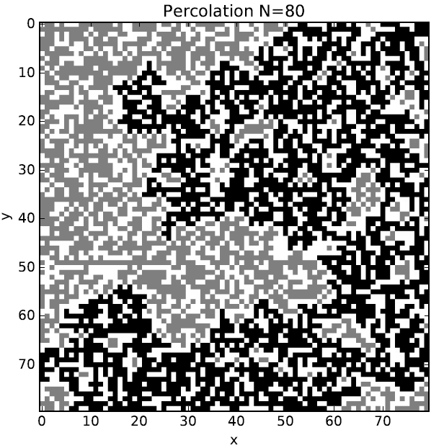
Percolation
Xuejian Ma
Tianyu Dai
Yuheng Liao
Xiaoqing Li

Slide 2
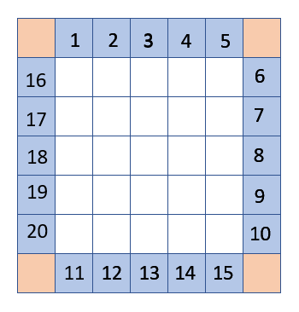
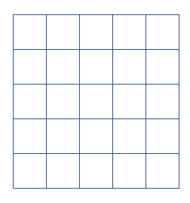
N×N lattice
(N+2)×(N+2) lattice
Notes:
Begin with an empty lattice and initialize all sites to zero.
A way to deal with boundary condition: enlarge a N×N lattice to a (N+2)×(N+2) one
Thus, every site equally has 4 neighbors
Then we label the blue boxes with numbers 1 to 4N
Since the four orange boxes have nothing to do with the grid which we are interested, we just ignore them

Slide 3
27
27
21
26
22
25
26
24
26
26
23
24
26
24
Notes:
Select and occupy a random site, labeling it with number 4N+1, since it is the first cluster. Select another site at random and check neighboring sites to see if any belong to a cluster.
If no, this new site is labeled with next cluster
If yes, we give this mark number to all the neighboring clusters to make them a new bigger cluster.

Slide 4
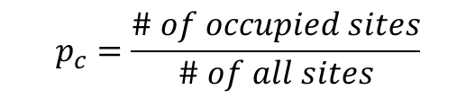
33
33
33
33
33
33
33
33
33
33
33
33
33
33
33
33
33
33
33
33
33
33
33
33
33
33
33
33
33
33
33
33
33
33
33
33
27
27
33
33
27
33
33
27
33
26
33
$$p_{c}=\frac{\# of occupied sites}{\# of all sites}$$
Notes:
Keep doing this, until the maximums of four blue lists are equal, which means a spanning cluster arises.
From the value of the spanning cluster, we can directly know how many sites (the Value-4N)are occupied.
Sweep the lattice we are interested (the small one), if its value equals to the value of the spanning cluster, we give 1 to it; if it is empty, we give -1 to it; otherwise, 0.

Slide 5
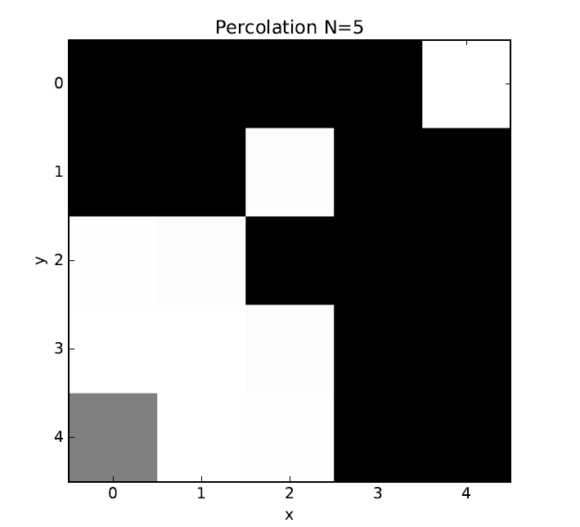
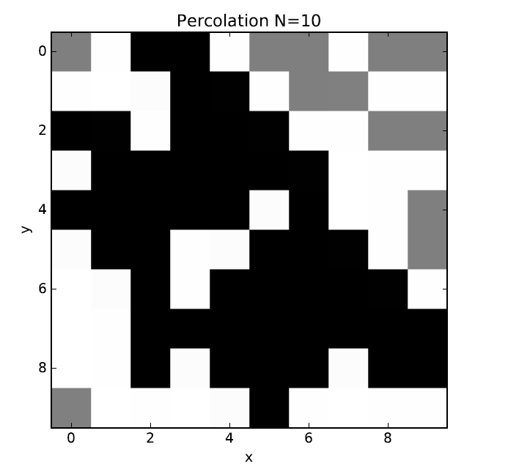
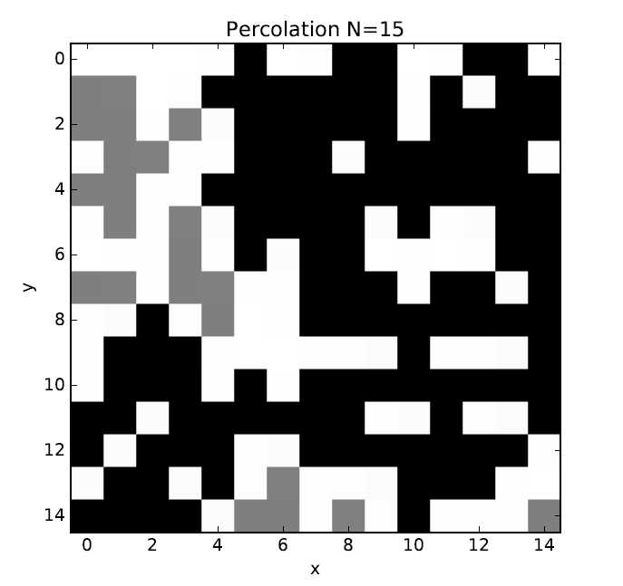
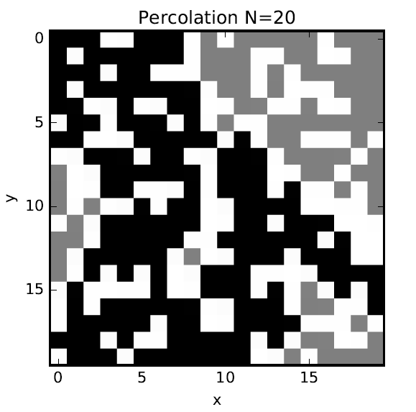

Slide 6
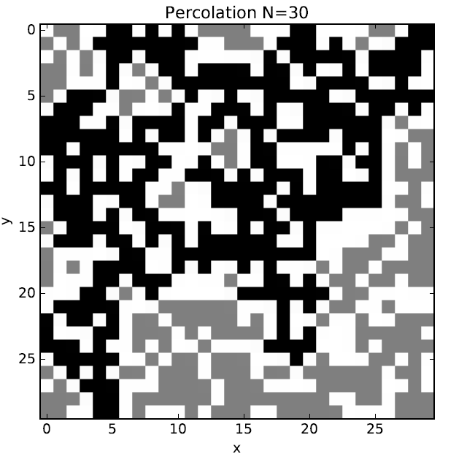
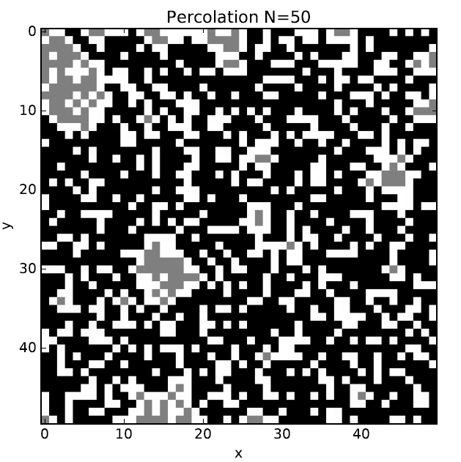

Slide 7
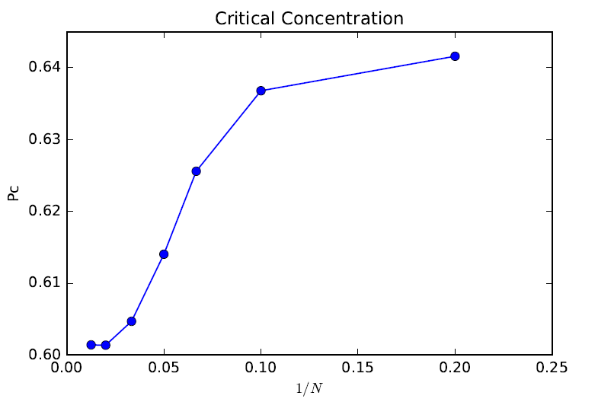

$$p_{c}(0)≈0.602$$

Slide 8

Keep tracking the number of the spanning cluster
33
34
33
34
33
33
33
33
33
34
34
34
34
34
33
33
33
34
34
34
34
33
33
33
33
34
34
34
34
34
34
33
33
34
34
34
34
33
34
34

Slide 9
